Slide 1
Rock your Profile and Resume Builder with LinkedIn
Sat, May 28 14:20-14:30

Slide 2
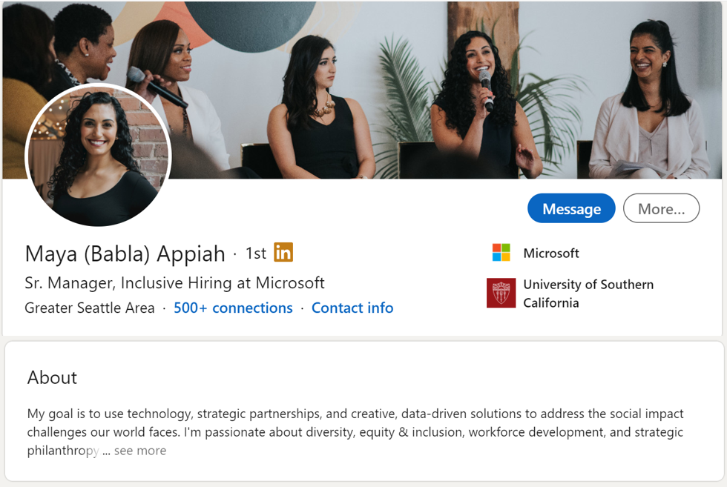
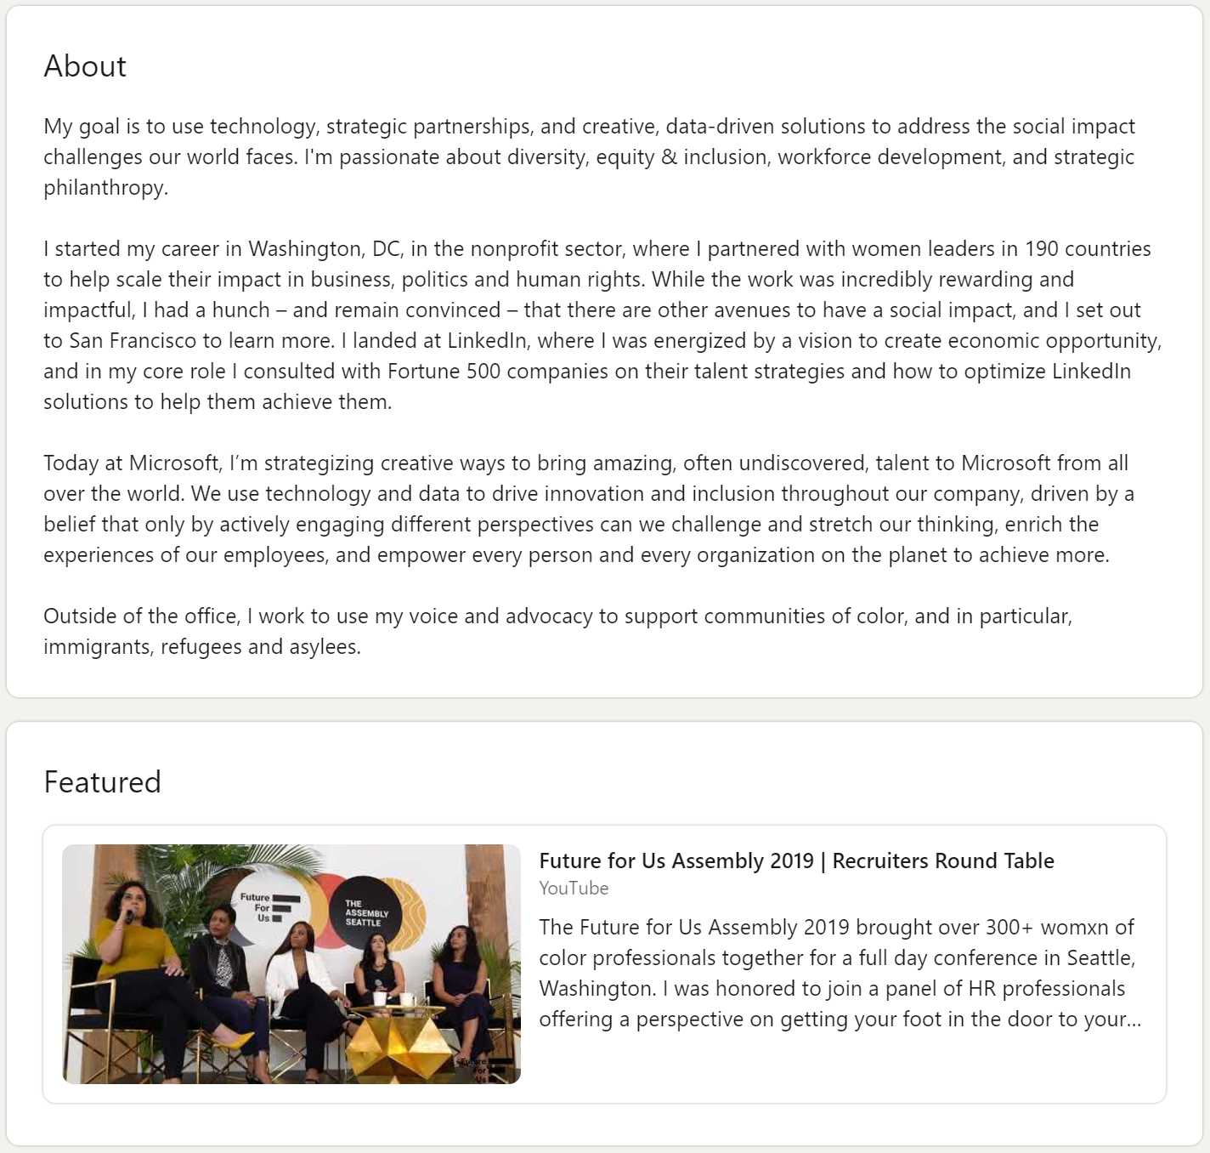
LinkedIn – Online CV
Profile & background photos
Headline
Contact information
Summary
Experience
Recommendations
Skills
Notes:
Linkedin in becoming more and more an online CV and your showcase of your own personal brand. Therefore, you should put just as much time into your LinkedIn. Companies are accepting candidates directly through LinkedIn
There are 6 core foundations to a solid profile which are
Clear and professional picture . Doesn’t have to be serious but something you would want your employer to see. Equally a background can really help you profile pop, I’d personally recommend either a photo of yourself, or a picture of your company/university
Headline: A one liner . Even if you’re just a student, showcase your university and what you’re studying
Contact information – Ensure it is update to date – last thing you want is for someone to reach out to you but to the wrong email address!
Summary - Executive summary/ elevator picture of who you are, what you've done and where you are aiming to go.
Who you are
What you do
Why your work matters
Your impact
Experience - All relevant experience – tailored with what you actually did. Start each line with a verb such as “Presented to XYZ” or “Analysed X amount of data”
Add any experience to demonstrate your expertise and experiences. This can be part time work, volunteering etc. What it does is showcase your work ethic as I experienced first hand how my partime job during uni and sixth formed played a big role in my being offered a placement at IBM.
Recommendations - Let your network speak for themselves. Ask people directly for feedback through feedback that can be showcased on your profile. Improves credibility
Skills – Search Engine Optimization tool. Employers search for skills and if you match these skills you will appear on their search. You can add them yourself or take skill quizzes
Demonstrate who you are – What are you passionate about? What impact are you driving? This is your brand page

Slide 3
Ways to Engage
Show gratitude
Congratulations or best wishes
Share a Status Update
Comment on a Status Update
Utilize LinkedIn Articles
Recognize your network
Notes:
Creating the best profile is pointless if you don’t get it out there in front of people. Ultimately it is a social networking, just like twitter and Facebook, when you’re liking and interacting with over profiles, you appear on their profile.
Loads of ways to do this
Share a status update, potenially sharing a recent accomplishment
Comment on someone’s status update, perhaps asking a question or offering your opinion
LinkedIn is full of people celebrating, so take the time to congratulate people on promotions new roles etc
Like, Love, Celebrate, Support, Insightful, Curious are all forms of showing graduate
Share articles either LinkedIn articles which are free, or articles elsewhere as this shows you are passionate about a certain industry/topic
Even if you don’t know people that well, interact with them to get yourself out there and grow your network.

Slide 4
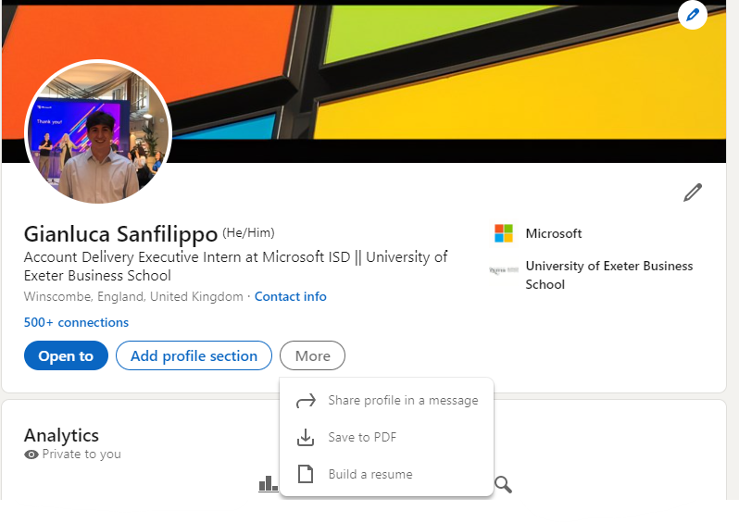
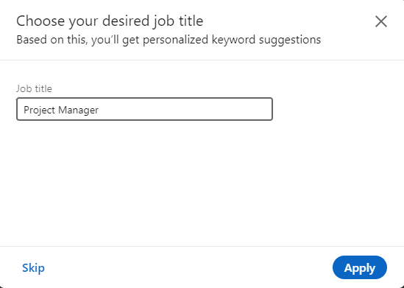
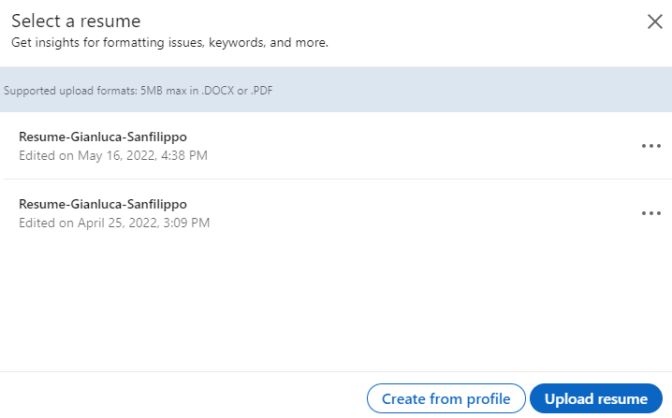
Notes:
With people spending more time and time on buildering their LinkedIn, it makes building a CV even more tedious! That is why I wanted to highlight this really cool feature on Linkedin that generates a CV from your LinkedIn profile.
In order to do this
Go to your profile, click the more button then select build a resume.
Here you can either upload a copy of your CV you have already made, click on a previous CV or create a new CV from scratch by clicking “create from profile”
One really cool feature is that you can add the role you’re interested in.. This will then create your CV, trying to use buzz words for that specific role and also help you review your CV based on your desired role!
Click Apply then your CV will be made

Slide 5
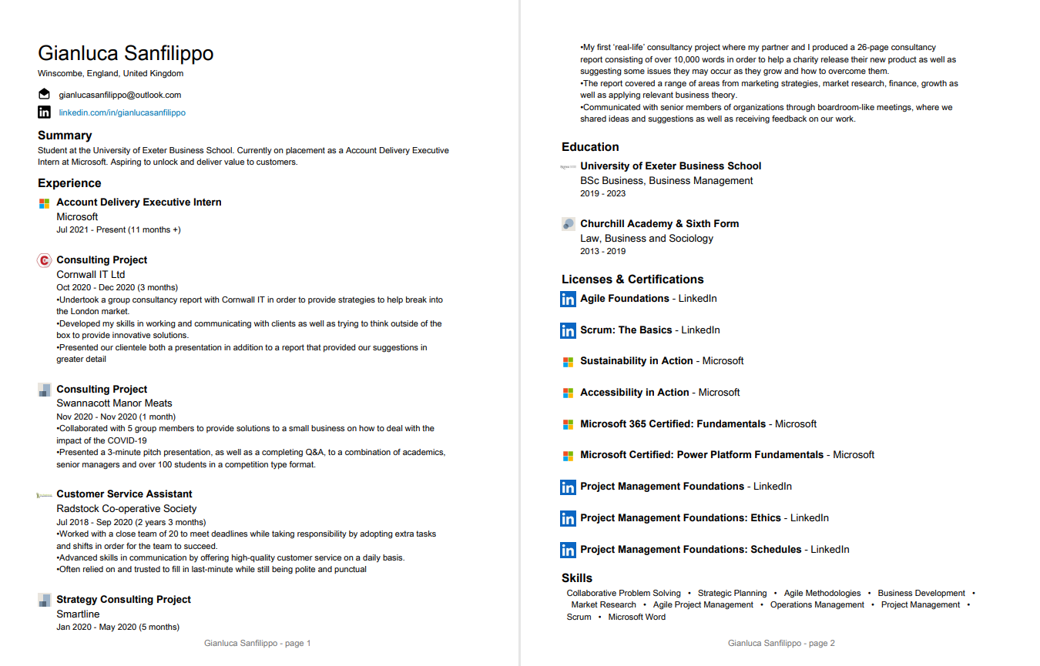
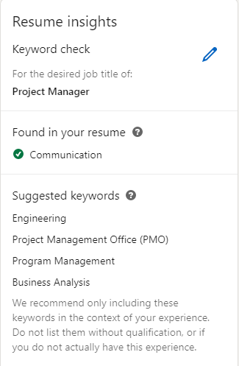
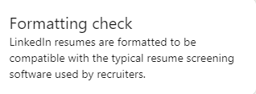
Notes:
Here is my CV generated from LinkedIn, you can see it not only adds your contact details, experiences but also certifications and skills that align with your desired job title. For example, more me I selected project manager so Linkedin have tried to direct my skills in a way that would favor the PjM role.
Additionally once you created your CV there are some really cool extras.
Firstly it gives you resume insights to see what your CV does well but also suggestions in order to better your chance of matching your desired role.
Also the Formatting check means that when you’re applying to a big company, with 100s of applicants, CVs are often firstly read through software. The formatting check ensures this CV can easily be read by resume screening software to better your chances of your CV being read b an actual recruiter !
That covers everything in my session but hopefully I start to see you all appearing on my LinkedIn newsfeed!! Thank you all and enjoy the rest of the day!

Slide 6
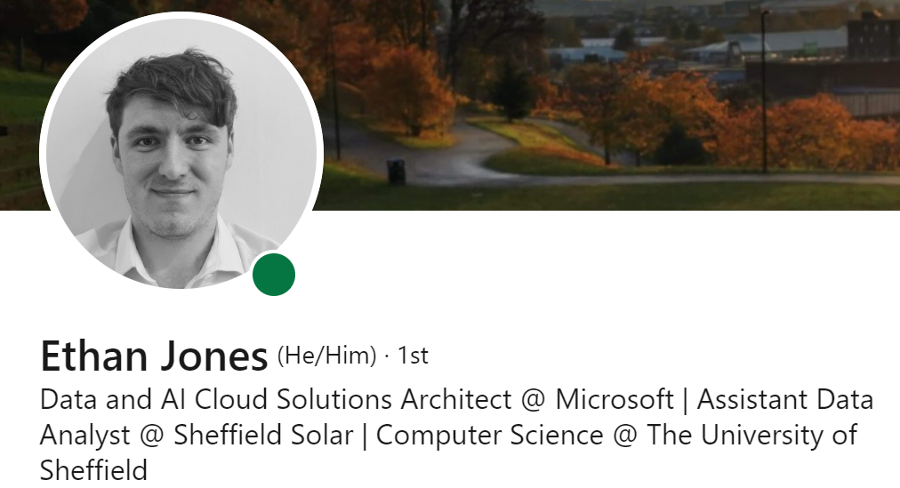
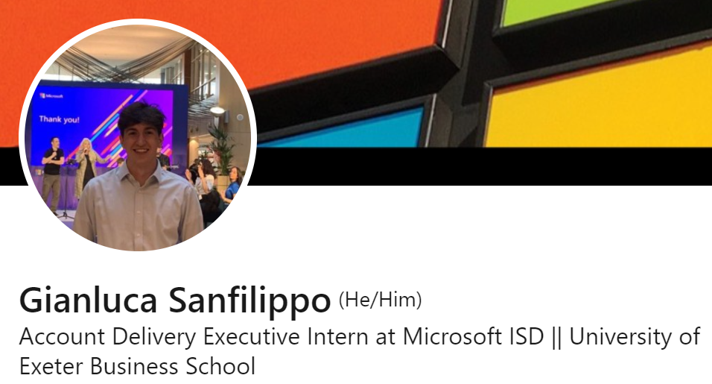
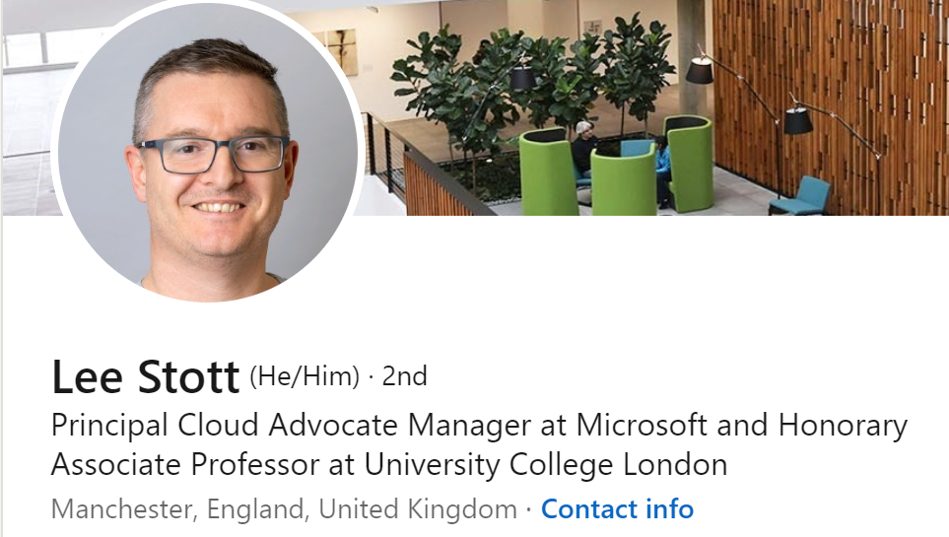
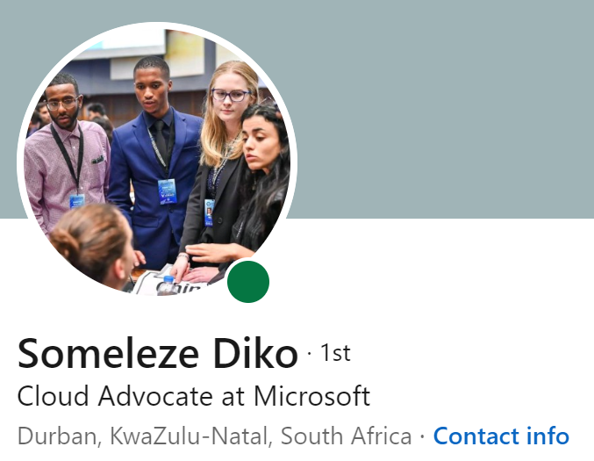
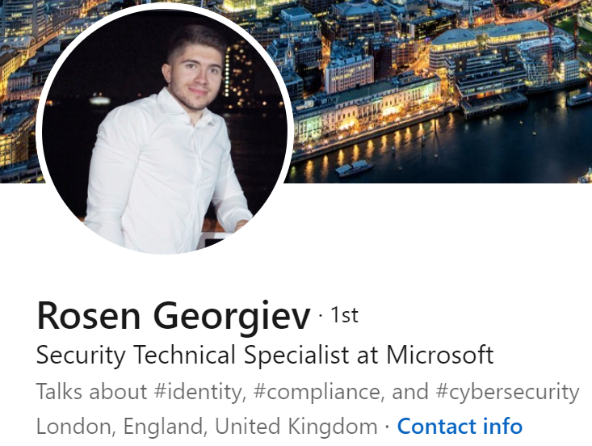
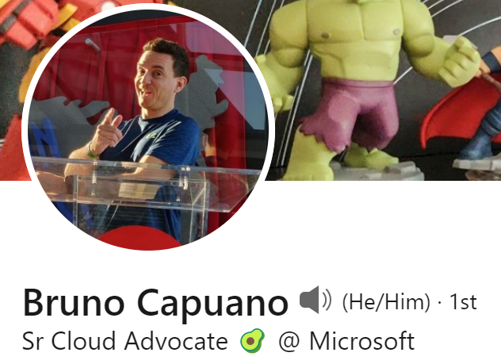
Connect with Us!
Notes:
Creating the best profile is pointless if you don’t get it out there in front of people. Ultimately it is a social networking, just like twitter and Facebook, when you’re liking and interacting with over profiles, you appear on their profile.
Loads of ways to do this
Share a status update, potenially sharing a recent accomplishment
Comment on someone’s status update, perhaps asking a question or offering your opinion
LinkedIn is full of people celebrating, so take the time to congratulate people on promotions new roles etc
Like, Love, Celebrate, Support, Insightful, Curious are all forms of showing graduate
Share articles either LinkedIn articles which are free, or articles elsewhere as this shows you are passionate about a certain industry/topic
Even if you don’t know people that well, interact with them to get yourself out there and grow your network.

